Slide 1

City of Cambridge Swimming Club and Water Polo
Annual General Meeting – Wednesday 9th JUlY 2025

Slide 2
Agenda
Record of apologies
Number of SE voting members present
Approval of 2024 AGM minutes
Matters arising from 2024 AGM - (none)
Chairman’s report of the activities of the Club during the previous year
Accounts of the Club for the previous year
Treasurer's report as to the financial position of the Club to date
Report on the accounts of the independent examiner & confirmation OF WENDY ELLIOTT remaining in office of the independent EXAMINER
New Resolution - Proposal for the club to apply for charitable status
APPOINTMENTS OF WELFARE OFFICERS
Election of the Executive Officers and other members of the Committee
Honorary membership
Head coach report
AOB

Slide 3
RECORD OF APOLOGIES

Slide 4
Number of SE voting Members present

Slide 5
APPROVAL OF 2024 AGM Minutes

Slide 6
MATTERS arising from 2024 AGM (none)

Slide 7
Chair’s Report – COCSC AGM
Key Topics:
Vote of thanks
Review of 2024-25
Club Finances
Review of Membership Survey
Goals for 2025-26 Period
Motion for Members – To Transition COCSC to a Charitable Incorporated Organisation (CIO)

Slide 8
VOTE of THANKS
There are lots of people to thank for their hard work over this period:
Management Board and Officers
Our regular ‘behind the scenes’ helpers
Finance Committee members for preparing the accounts
All the volunteers supporting our Swimming AND Water Polo sections
Meets Team and Gala Entry Team
The Swimming & Water Polo Coaching Team
Admin Officer, Anne
Notes:
My name is Jon Bell and I was co-opted to the vacant role of Chair of the club when my predecessor stepped down. I have been a member of the club on and off since 1987 and have seen a lot of things change.
My first act as Chairman at my first AGM is to make a vote of thanks to the army of volunteers and professional staff who keep the club on its feet.
It’s a terrible cliché, but I won’t even try to name all the individuals however you are all appreciated, particularly the Computer Team, the Meets and Gala Entry team, our great coahes and of course Anne, our admin officer.
Like most clubs we rely on volunteers for many of the activities, including competitions and general running of the club. Whilst we are often referred to as ‘The Board’ or ‘The Executive Committee’ we are in fact a small group of individuals, each with responsibilities outside of the club and who do our best to ensure that things run smoothly.
We are always looking to expand our talent so please let us know if you’d like to volunteer in any capacity, either as a one off or on a regular basis. It’s incredibly rewarding.

Slide 9
Review of 2024-25
Achievements :
Challenges and Headwinds:
Implementation of the new Squad Structures since last year
Integration of the Perse pool into our program
Implementation of the ‘GoCardless’ system of payment
Delivery of a Training Camp in Turkey
COCSC Water Polo players representing Eastern Region
Regular Newsletters – this is the primary resource for communication
Recruiting volunteers and committee members to ensure good governance of the club
Aging equipment (blocks, starting equipment, timing systems) which will need repair/replacement in an environment where budgets are tight
Maintaining the Club Reputation at our Pool Providers
Bringing the Club Finances back into surplus

Slide 10
Membership Review
As of 7th July 2025:
Category | 24-25 | 23-24 | Difference
Membership | 797 | 790 | 7
Swimmers/Players | 573 | 564 | 9
Volunteers/Parents/Coaches | 224 | 226 | (2)

Slide 11
Financial Overview
Sep 2023-Aug 2024 a strong year with net surplus of £27k added to club reserves
Financial Accounts (QuickBook) have been tidied up for all previous years
A few major repairs and maintenance items expected in the next few years.
We will likely Exit 2024-25 with a small operating loss but strong reserves

Slide 12
Financial Overview - Sep 2024-Aug 2025 Forecast
Highlights
Training fee and membership fee income increased from fee increases and new members joining the club
Meet income increased by 8% compared to previous year (i.e. Grand Prix)
Started holiday pay for all hourly coaches from September 2024 as planned
Hourly coaches rate increased in line with statutory minimum wage increase in April 2025
Club reserves in healthy position
Costs increase
Expanded training sessions result in increased pool costs (Perse pool) and coaching costs
Club member increases lower than expected for some squads (i.e. Master 3 squad)
Operational cost increased driven by GoCardless fees and repair costs. There are some major repairs and maintenance needed in next year with discussions ongoing with City Council
We anticipate a fee increase for the 2025-26 season in line with inflation

Slide 13
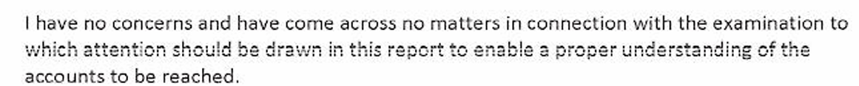
Independent Examiner Report Wendy ElliotT
Wendy has examined the accounts and reported:
A copy of her full report is available on request by emailing treasurer@cocsc.org.uk
Wendy has agreed to remain our independent examiner for next year.
Notes:
I’ll conclude with the Targets for the Next twelve months:
We will build on the governance and running of the club
Work hard to secure and train more volunteers to lighten the workload on the existing team
Transition to the Perse Pool
Implement the Go-Cardless payment system and integrate it into our accounts software – which apparently isn’t as easy as it sounds.
I’ll stop here because I understand that there’s an important football game later this evening.

Slide 14
Membership Survey
Survey Key Points
All club members surveyed
188/481 recipients responded (39%)
Response rates from individual squads ranged from ~17% to 80%

Slide 15
Membership Survey
Key Points
Knowledge of Squad Entry Criteria is quite high
Pathway Squad has the lowest knowledge of SQuad Criteria

Slide 16
Membership Survey
In Most Squads, Attendance Levels are High
Early Starts/Late Finishes Appear to Represent the Main Challenges to Attendance

Slide 17
Membership Survey
Satisfaction with Parkside and the Perse are High – Overall the Leys is the Least Preferred Pool

Slide 18
Membership Survey
For Most Squads, Communication by email and via the App appears most effective
Willingness to Volunteer Appears Highest in Parent of the Performance Squads

Slide 19
Goals for 2024-25
Bring the Club finances back into balance
Secure Sponsorship for one or more of our Open Meets
Work with the council to renew the equipment, which is reaching the end of it’s operational life
Start the journey towards becoming a Charitable Incorporated Organisation (CIO)
Notes:
I’ll conclude with the Targets for the Next twelve months:
We will build on the governance and running of the club
Work hard to secure and train more volunteers to lighten the workload on the existing team
Transition to the Perse Pool
Implement the Go-Cardless payment system and integrate it into our accounts software – which apparently isn’t as easy as it sounds.
I’ll stop here because I understand that there’s an important football game later this evening.

Slide 20
Motion for Members

Slide 21
Executive Summary
COCSC is currently unincorporated
Three options have been evaluated
Registered Charity
Charitable Incorporated Organisation
Community Amateur Sports Club
The CIO model appears to be the most attractive option
Single registration with the Charities Commission
Not liable for Corporation Tax
Potential for ‘Gift Aid’ to be claimed on membership fees
Limited liability for Trustees
Motion: Does the Membership Agree to the Committee’s Proposal to start the transition to becoming a CIO?

Slide 22
A range of Alternatives have been evaluated
Registered Charity
Can take various legal forms, such as a charitable trust, unincorporated association, or charitable company
If structured as a charitable company, it must register with both the Charity Commission and Companies House.
Is a UK Based Sports Club that meets certain criteria laid down in 2002
Charitable Incorporated Organisation (CIO)
More administrative requirements, especially for charitable companies.
Trustees may have personal liability unless the charity is incorporated.
A specific legal structure designed for charities, registered only with the Charity Commission.
Has limited liability for trustees, meaning they are not personally responsible for debts.
Less administrative burden compared to a charitable company.
Can enter contracts and own property in its own name.
Community Amateur Sports Club (CASC)
It offers similar Tax Benefits to the Registered Charity Model
Registration is described as simple
You cannot be both a CASC and a Charity*
Single registration with HMRC
Preferred Option

Slide 23
Benefits and Drawbacks of Becoming a CIO
Benefits
Limited Liability: Trustees are not personally liable for the charity’s debts, protecting individuals involved
Single Regulatory Body: CIOs are regulated only by the Charity Commission, unlike charitable companies, which must also report to Companies House
Simplified Reporting: CIOs have fewer administrative burdens compared to charitable companies, making compliance easier
Legal Personality: A CIO can own property, enter contracts, and employ staff in its own name, rather than relying on trustees
Public Trust & Funding: Charitable status can enhance credibility, making it easier to secure grants and donations
Drawbacks
Exclusively Charitable Purpose: CIOs must operate only for charitable purposes, limiting flexibility in activities
Irreversible Registration: Once registered as a CIO, it cannot revert to an unincorporated structure
Regulatory Scrutiny: CIOs must comply with strict Charity Commission regulations, including governance and financial reporting
Limited Trading Ability: CIOs face restrictions on commercial activities, requiring a separate trading subsidiary for significant business operations
Time-Consuming Setup: Establishing a CIO requires formal registration, which can take longer than setting up an unincorporated charity

Slide 24
Appointments of WELFARE OFFICERS
Amy Shayle remains Welfare Officer
Lindsay Harvey is appointed Welfare Officer

Slide 25
Election of the Executive Officers and other members of the Committee

Slide 26
Nominated Members
Position | Status | Nominated | Seconded
Chairperson | M | Jonathan Bell | Nicky Phillips
Secretary | M | Sally Nicholl | Sylvaine Bruggraber
Treasurer | M | Maggie Lang | Peter Rank
Member 1(optional) | E | Katharin Page | Amy Shayle
Member 2(optional) | E | Salvatore Di Maggio | Debora Lucarelli
Member 3(optional) | E | Daniel Mannion | Hugh Phillips
Member 4(optional) | E
KEY:
Hon – Honorary M – Mandatory E – Elected

Slide 27
VOTE to Elect Committee
All 16-year-old and over members of the club are entitled to vote.
Please complete the googleform following the link for ‘vote committee’ in the chat.

Slide 28
Honorary Membership
Peter Rank remains our Honorary President.

Slide 29
VOTE ON Motion for Members
Does the Membership Agree to the Committee’s Proposal to start the transition to becoming a CIO?

Slide 30
VOTE on Proposed Motion
All 16-year-old and over members of the club are entitled to vote.
Please complete the googleform following the link for ‘vote motion’ in the chat.

Slide 31

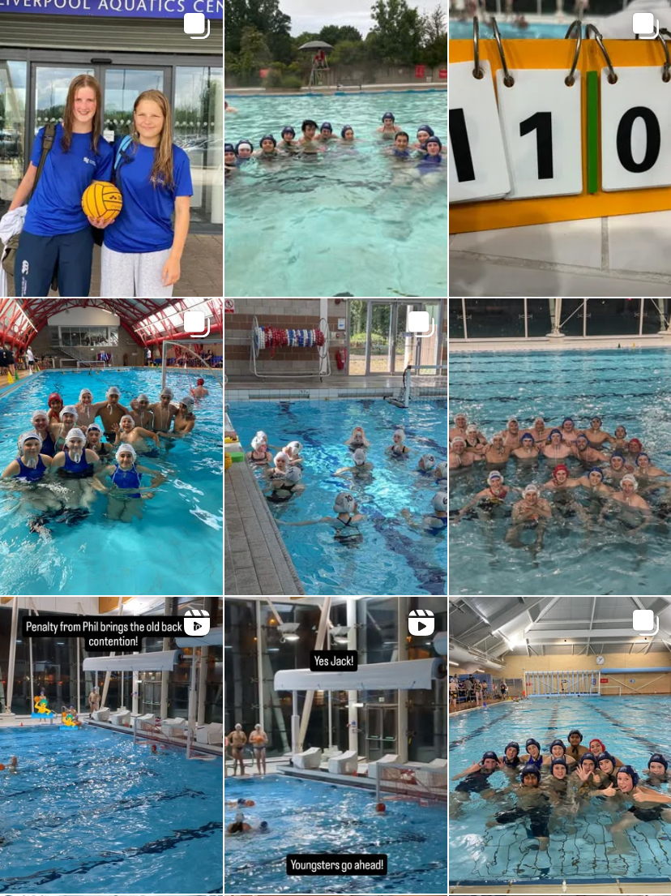
Water polo UPDATE Compiled by Matt McGeehan
Another positive year for water polo, with great enthusiasm and appetite from Cambridge members.
Representative water polo - Anya J, Emilina B, Yibo L, Pietropaolo S, Margarida F have all represented the East Region.
Participation numbers of young players continue to grow with the support of the club. The incoming schedule is very positive for water polo.
Recruitment - we are keen to recruit swimmers or former swimmers who will make the transition to water polo quickly. The sports are complementary! Email waterpolo@cocsc.org.uk for a taster session.

Slide 32
HEAD COACH report 2025
James Freezer

Slide 33

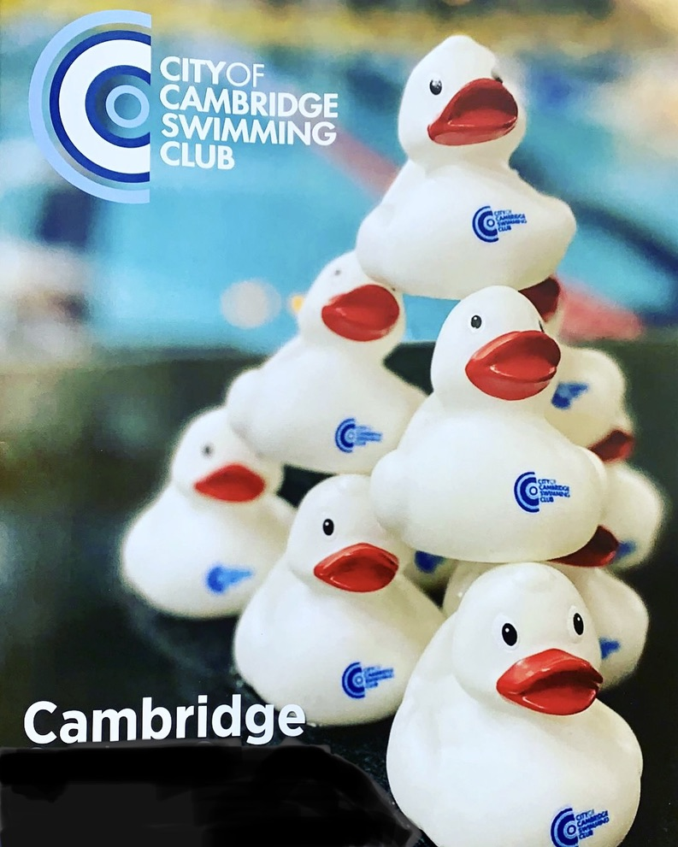
Club Plan / Vision
The club wants to be a vital part of the community in the widest sense. the club’s success should be measured both in and out of the pool; Its success should not just be measured by its national & Regional qualifiers. but by the numbers throughout the club and the club’s ability to cater to the widest possible range of abilities.
Alongside this the club wants to offer volunteer and job opportunities to young enthusiastic members who want to give back

Slide 34
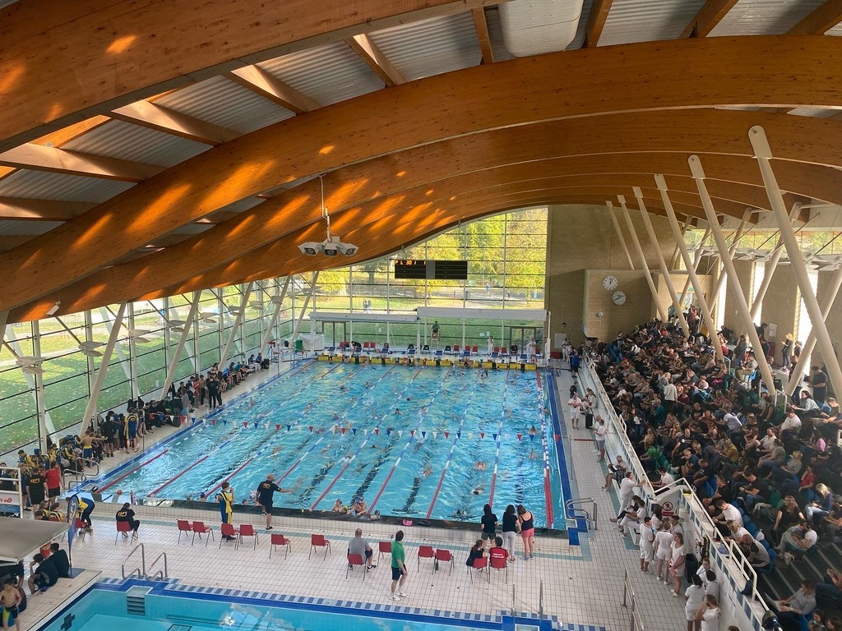
New Perse school Pool
A successful integration of The Perse facility during the 2024–25 season has laid a strong foundation for growth. Building on this, we are expanding to five nights per week (Monday to Friday) for the 2025–26 season. This increased access enables more flexible and consistent training, reduces late finishes for key squads, and represents a significant step forward in the club’s ongoing development and commitment to athlete wellbeing and performance.
6x25m Lane Pool - 5X Nights Per Week
Monday - 18:35-21:05
Tuesday – 17:45-19:45
Wednesday - 18:35-20:35
Thursday – 19:45-20:45
Friday - 18:35-20:35

Slide 35
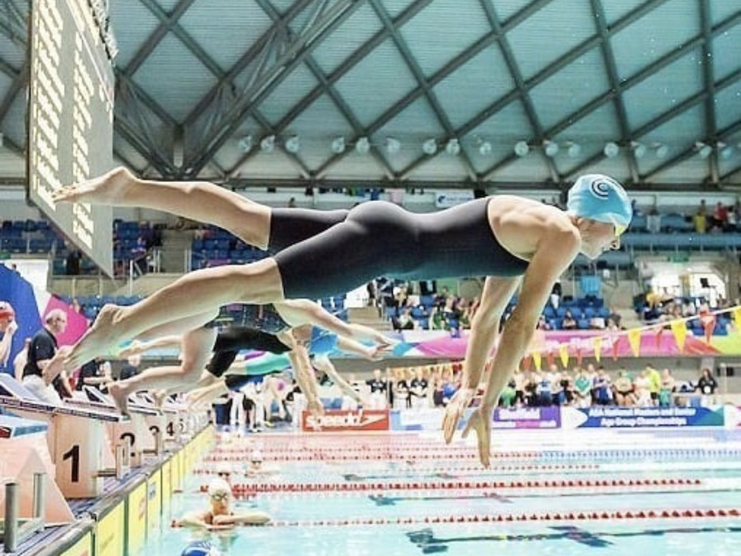
Achieved Targets
Training camp February 2025 (45 Athletes + 6 staff)
The recent training camp at the world-class Gloria Sports Arena in Turkey was a huge success, providing an exceptional environment for athlete development. The week’s schedule was packed with high-quality, intensive training sessions in both the pool and gym, balanced with structured study time for those managing academic commitments. Equally important were the invaluable team bonding moments, which strengthened connections across the squad. The swimmers demonstrated outstanding commitment, professionalism, and enthusiasm throughout the camp, fully embracing the experience and making the most of the opportunity to train, learn, and grow together.
New Facility – Perse School
The successful integration of The Perse facility into an already busy schedule has provided the club with greater flexibility and access to high-quality training environments. Despite the demands of a packed timetable, sessions at The perse have been efficiently incorporated to enhance squad development without compromising training balance or quality. This addition has strengthened our capacity to support swimmers across all levels.

Slide 36
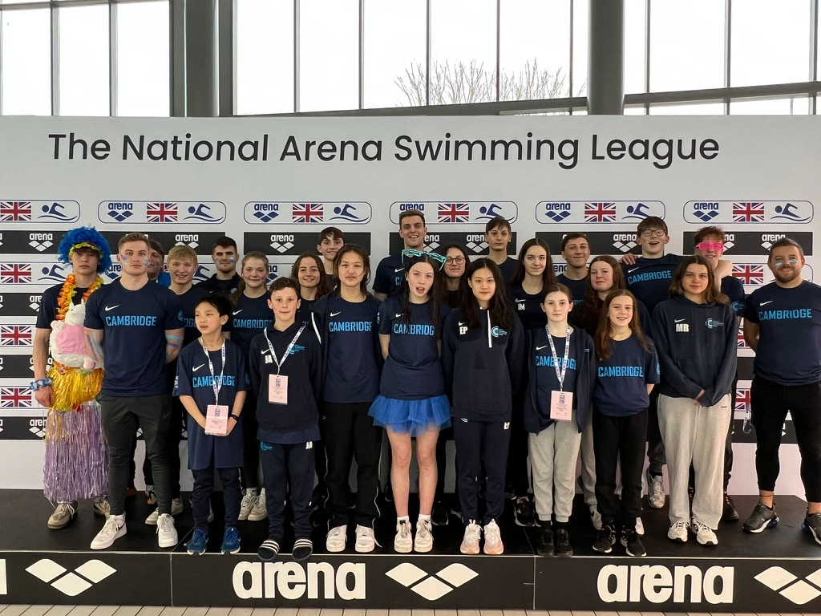
ARENA LEAGUE 2024
EAST MIDLANDS Arena League –A TEAM – 4th Place
National Virtual Gala results – 34th
B – TEAM finishing 15th in the EAST MIDLANDS league.
There were very good performances across all three rounds, with every swimmer stepping up and contributing positively. The consistency, effort, and team spirit shown throughout were excellent, and it was great to see athletes embracing the challenge and delivering strong swims across the board.

Slide 37
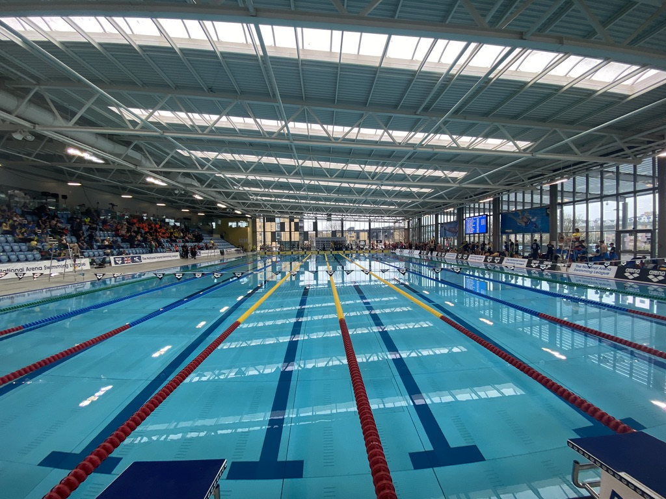
County/Regional/national Championships
Se east region para swim meet (September 24)– 3
National County Team championships (October 24) – 10
National masters SC (October 24) – 18
SE EAST Region SC CHAMPIONSHIPS (November 24) – 43
Winter SC Nationals 2022 (December 24) – 12
CAMBRIDGESHIRE County (JANUARY 25) – 127
British Championships (APRIL 25) – 9 + 3 non entered qualifiers (2X a final / 5 x B Final / 1x jnr Final) + 1x silver medal (Claire connon).
SE EAST Region lc CHAMPIONSHIPS (April/may 25) – 60
NATIONAL MASTERS LC CHAMPIONSHIPS (June 25) – 12
National junior para championships (JUNE 25) – 2
National summer CHAMPIONSHIPS (JULY / AUGUST 25) – British – 19 + 6 rELAYS / English – 16 / Welsh – 4 / Scottish – 4
Total = 31 athletes achieving National qualification and recognition

Slide 38
Any other business

Slide 39
SGM/AGM planned for NOvember 2025
Swim England recommended the change of date for our AGM to be more in line with our financial year (1st Sept – 31st Aug)
Our constitution is due to be reviewed as per Swim England requirement

