Slide 1

Winning the Start
By Matthew Rothwell, Yasir Naimi and Fabian Brudnicki

Slide 2
Before we start
https://www.youtube.com/watch?v=z0HvMFNSxB8
What do you think is the most important part of the start?
What do you focus on when doing start practice in training?
What do you think is the hardest part of a start?

Slide 3
Contents
Block Stance:
Flight Phase:
Transition Phase:
Positioning on the block
Common mistakes
How to transition efficiently from the block and into the water
How to carry Speed underwater
Underwater posture and kick

Slide 4
Block Stance

Slide 5
There are 2 types of Block Stance

Slide 6
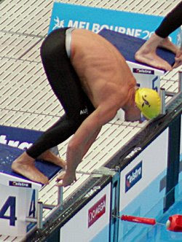
Grab Start
Feet are positioned together at the edge of the block
Hands either side of the feet
Seat higher than the shoulders
Body weight central

Slide 7
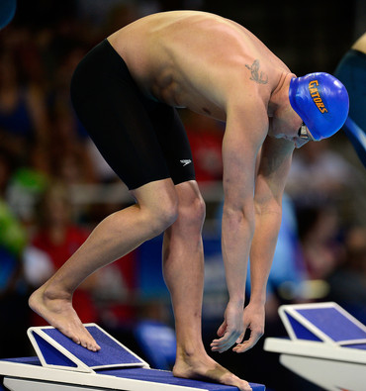
Track Start
Feet are split, with one at the front of the block and the other at the back
Hands in line with shoulders
Straight line from head to seat
Body weight tilted over front of block

Slide 8
Track Start Set-up
Place both of your feet at the front of the block, shoulder width apart
Move your weaker / non-dominant foot onto the block wedge
Curl toes of front foot over the edge of the block
Push through the Back foot until you can feel your leg muscles engaging.
Grip front of block with both hands

Slide 9
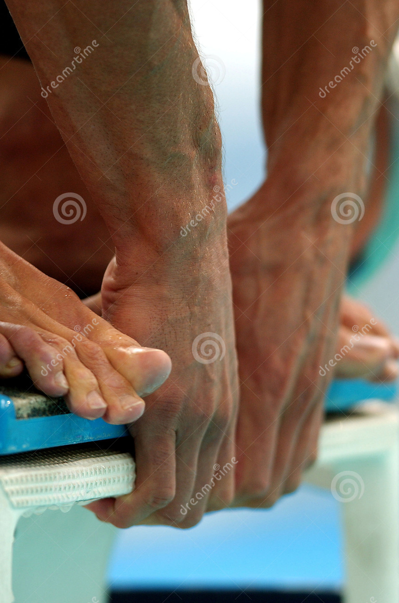
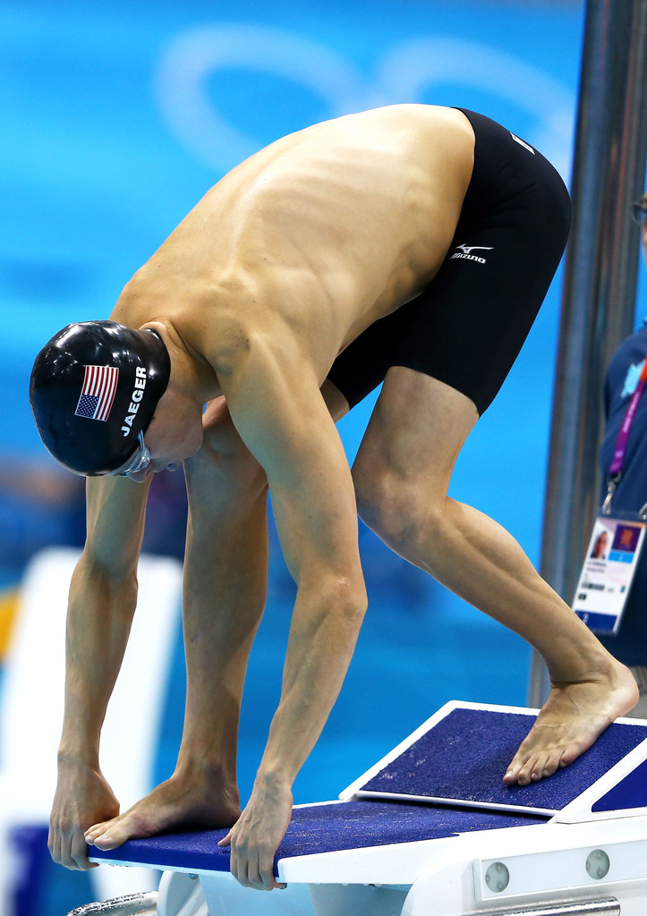
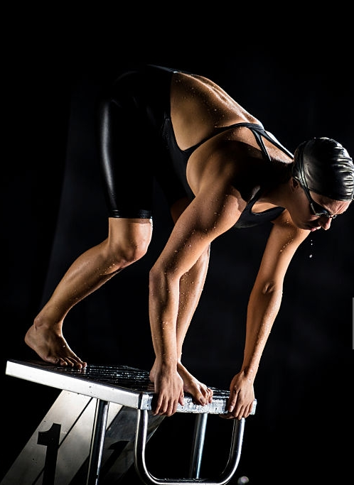
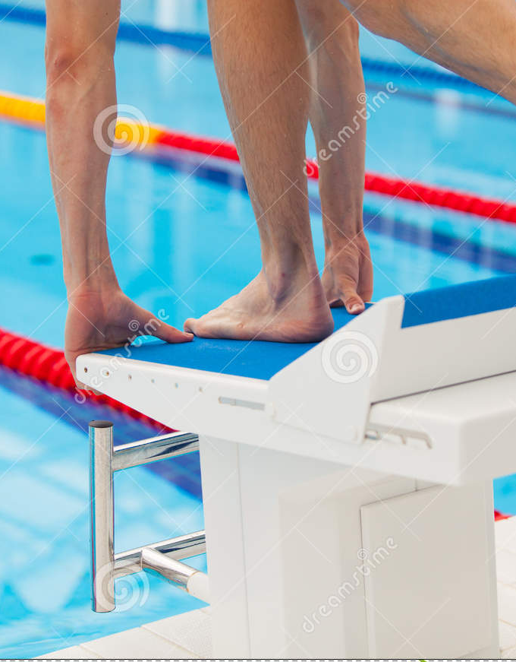
Hand Positioning

Slide 10
The 3 Common Mistakes
Swimmer leans to one side
The swimmer goes upwards when they dive
The swimmer Belly Flops into the water
Their weight isn’t central
Toes aren’t curled over
Back Leg isn’t being used.

Slide 11
If you do everything right
https://www.youtube.com/watch?v=zQSepvYgPMo

Slide 12
Flight Phase

Slide 13
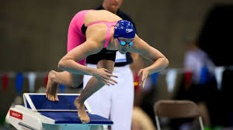
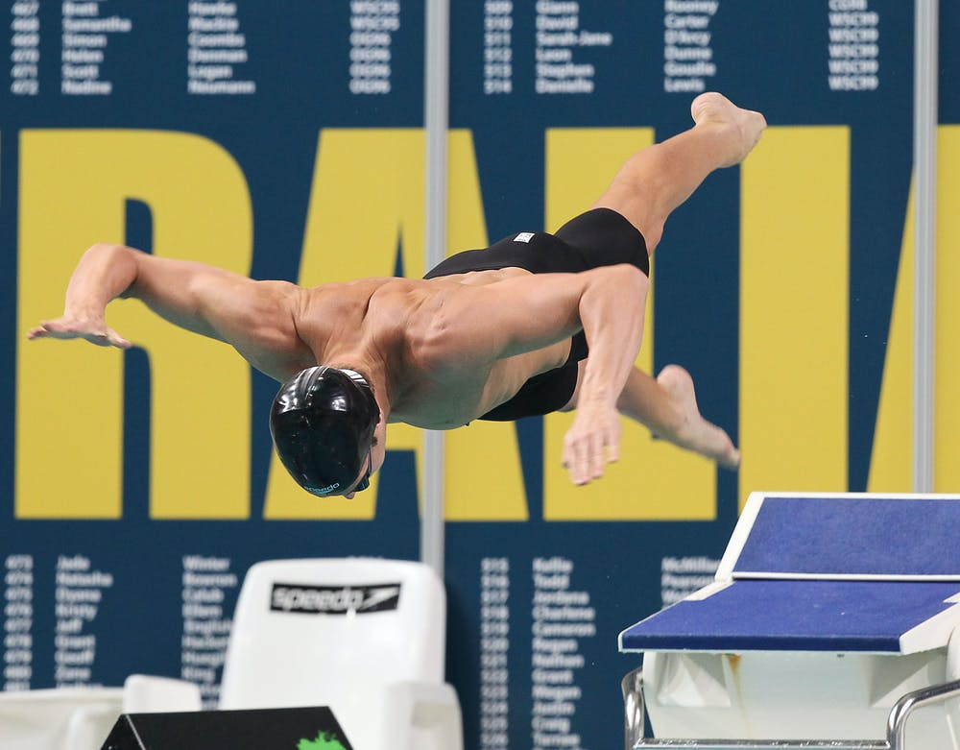
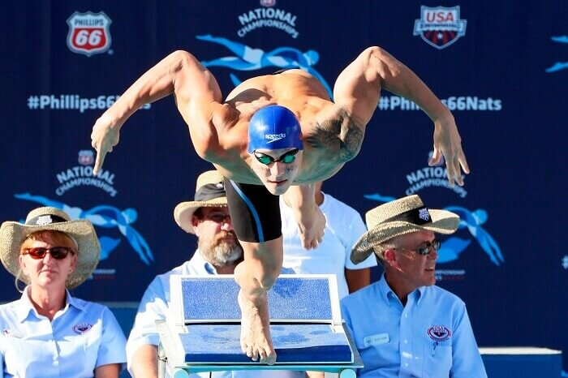

Forward Motion
Faster and easier to get into streamline position
Reduces air resistance
Backwards Motion
Arms back and their elbows high
Increases the power of their drive

Slide 14
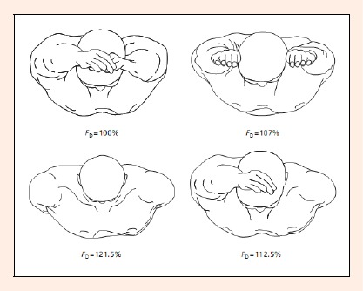
Key Elements To Consider In Flight
Your torso should reach extension mid-flight
Your front leg should now form a straight line from your head to your toe
Your head should dip between your arms to set up your entry line
“Every 1 second improvement = 3% more efficient”

Slide 15
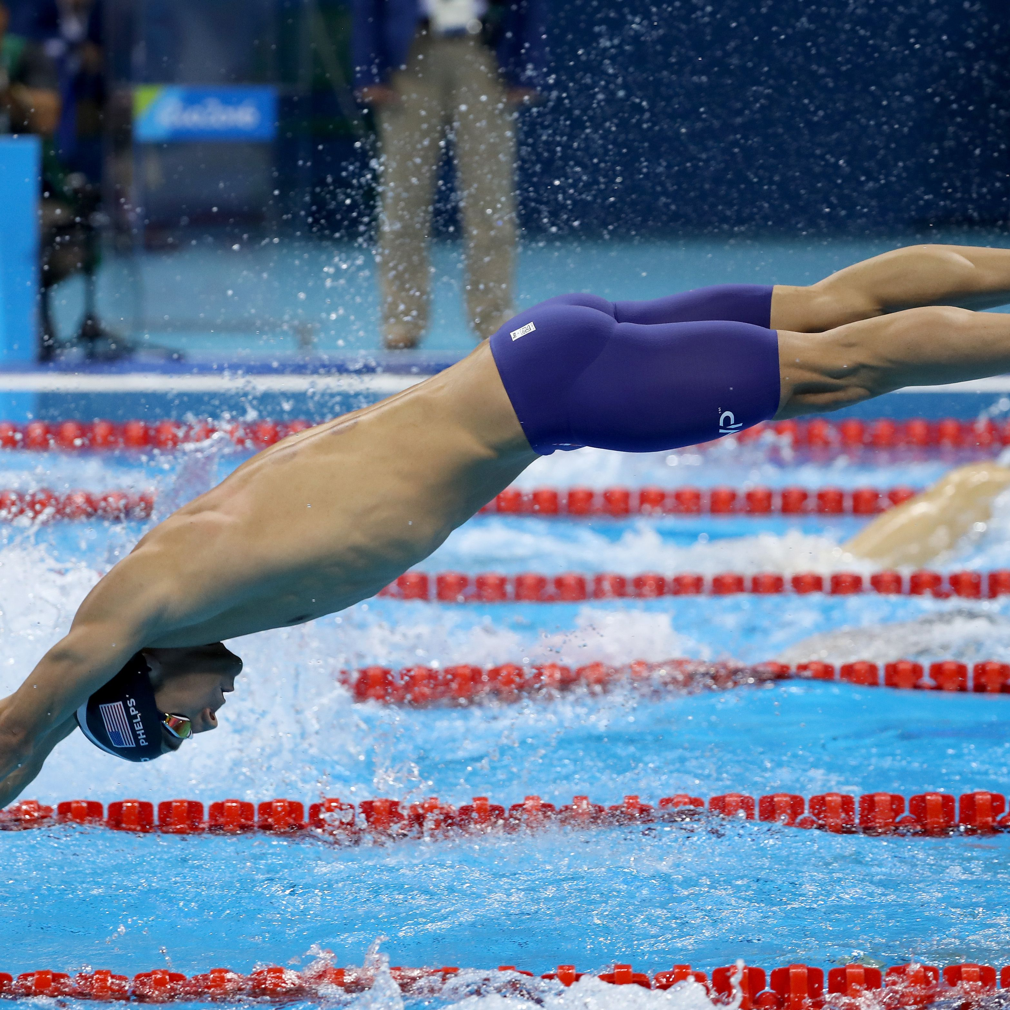
Entry
Your body line should be set before your hands pierce the water
You should have a slight pike in your body line, which will help smoothen the transition from the air to the water
Hold legs up in line as the torso submerges

Slide 16
Transition Phase

Slide 17
Video
https://www.youtube.com/watch?v=4xzjEyc7Kz4

Slide 18
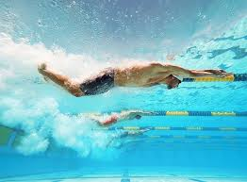
U/W Technique
Ankle Flexibility
Kick from the core and hips, and not the knee.
No upper body or hand movement
Kick both upwards and downwards
Maintain a tight streamline

Slide 19
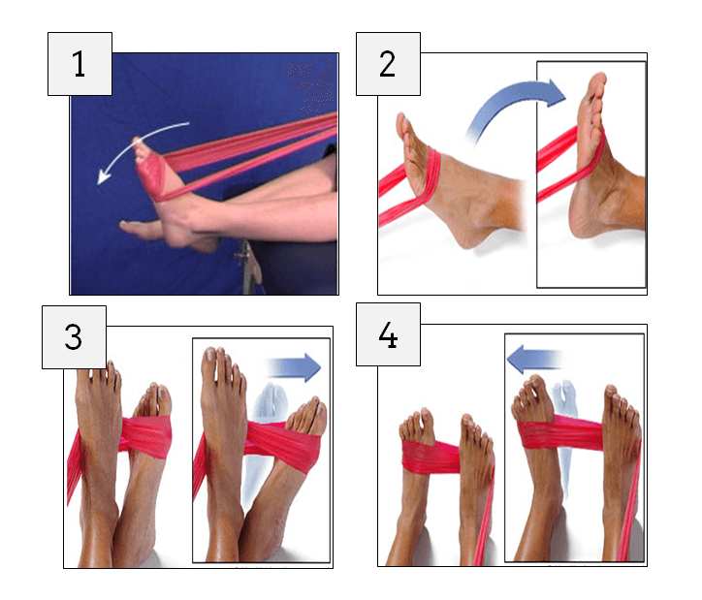
Plantar Flexion. Take a thereband, wrap it around the top of your foot, and sitting in the classic hamstring stretch position point your toes. Do 15-20 reps on each side.
Dorsi Flexion. Attach band on a door frame or something stable, and now you will pull the top of your foot towards you. Do 15-20 reps on each side.
Inversion. Wrap the band around your foot, and with resistance, twist your foot inwards. Do 15-20 reps on each side.
Eversion. Similar to the inversion, but now you are going to rotate your foot outwards. Do 15-20 reps on each side.

Slide 20
Any Questions?

Slide 21
Thank You For Listeneing

