Slide 1
Club Health Tracker:
ONB ASA
January 2024, Alice Fairhall

Slide 2




Why was the Club Health Tracker created?
How does it work?
What benefits does my club/ONB ASA get?

Slide 3
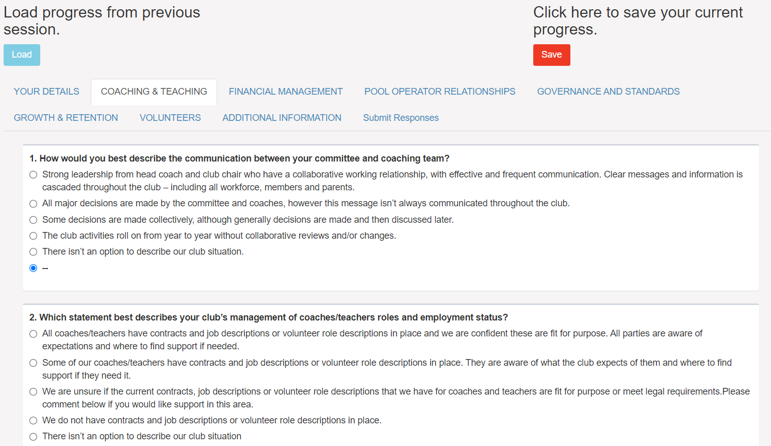
https://cultureofinsight.shinyapps.io/Swim-England_Club-Health-Tracker/
Notes:
Why did was the CHT created – Australian ports council, golf,
Like about CHT -

Slide 4
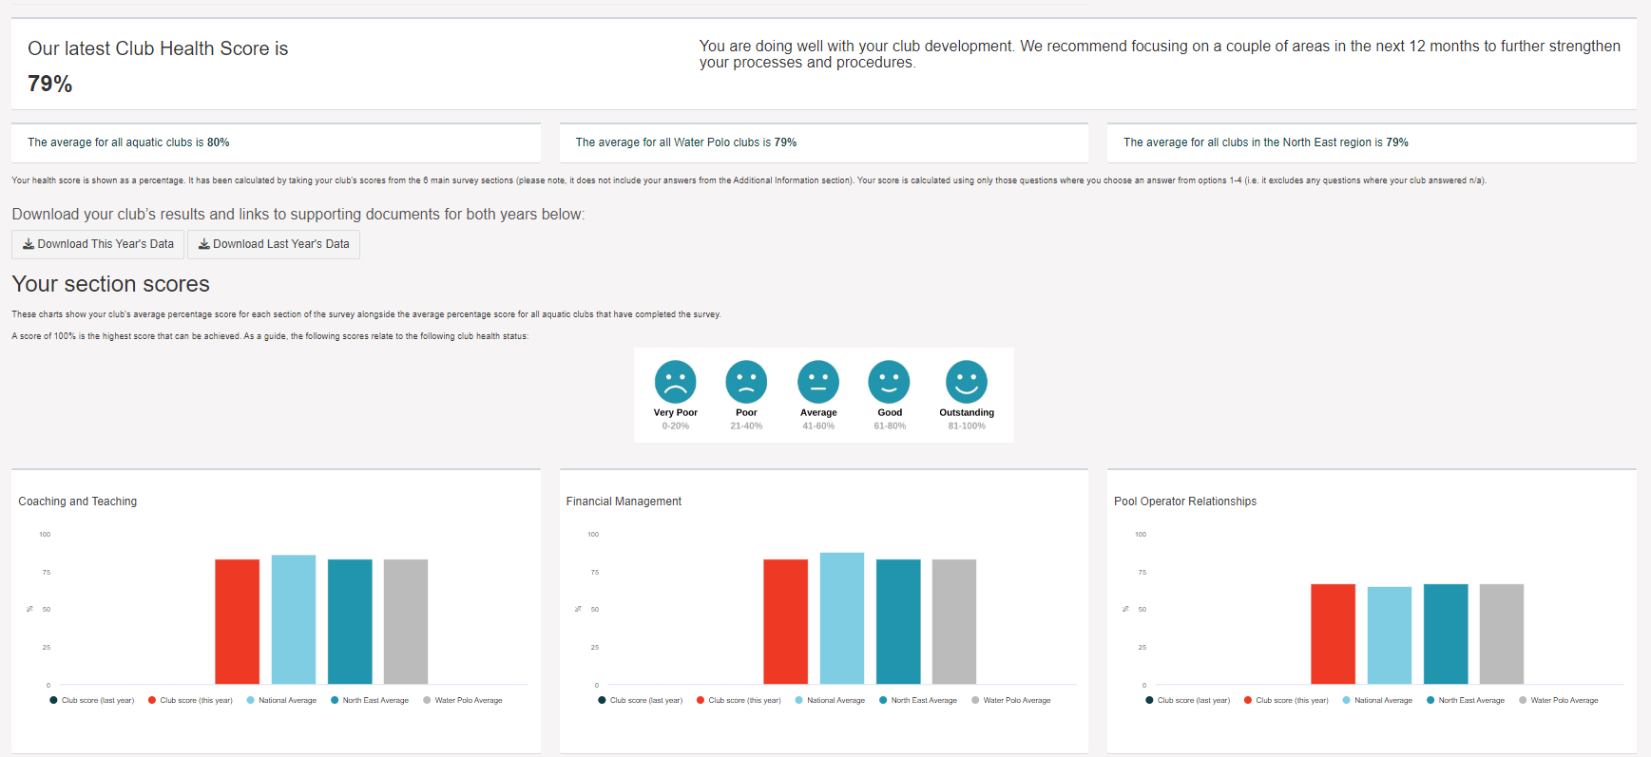
Instant results
1. Bench mark against regional averages
2. Download results and share with committee
3. No-one else sees your score, only you and Swim England

Slide 5
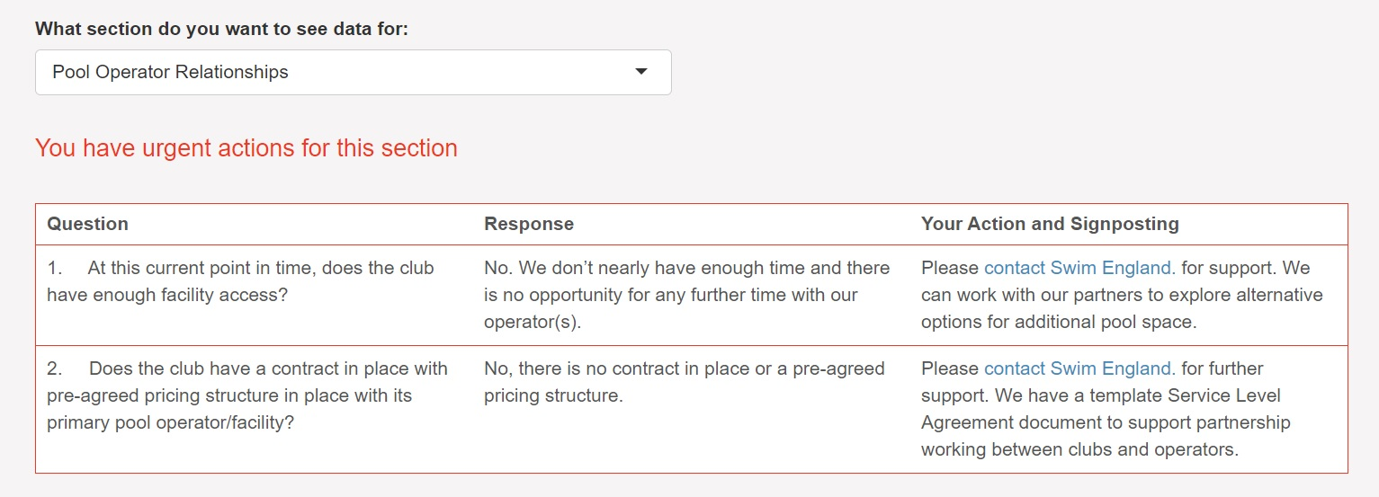
Urgent action response

Slide 6


Then what?
Signpost to specific resources
Help other similar clubs by sharing your good practice
Offer bespoke support

Slide 7

Listening and reporting
Collate trends and responses and feedback at every level of Swim England
Last years report = new projects for 2024
Can create in depth reports for ONB

Slide 8
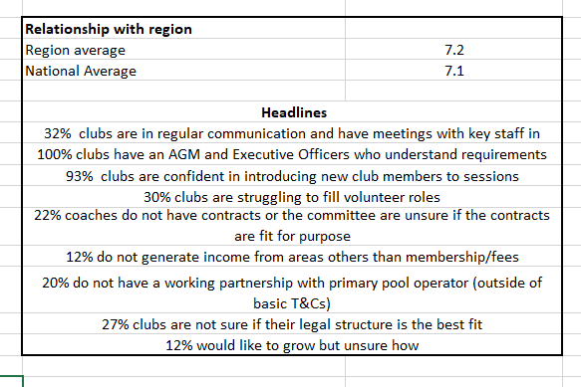

Slide 9




Summary
Email me for any help/log ins etc
Positive feedback from clubs in year 1
Takes about 10- 15 minutes to complete
Annual – this year closes in February 2024

Slide 10

Any questions?
Thank you ☺
alice.fairhall@swimming.org

