Slide 1
Nutrition for swimming focus points
“Swimming isn't everything , winning is .” Mark Spitz
Notes:
1

Slide 2
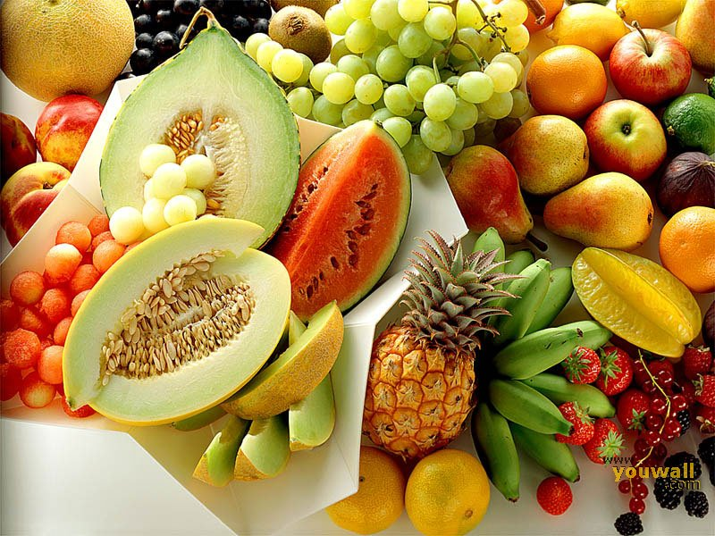

Slide 3
Eating rules pre training
Low saturated fat
Eat 3 main meals per day –
2 of these should contain protein e.g. lean meat and poultry + oily fish (Omega 3) , tofu or beans
2-3 between meal ,high carbohydrate snacks with fruit per day
The meal 2-3 hours pre training is key
Aisling Snedker RD Clinicaldietitian.ie
1/14/2023

Slide 4
Come to training fully fueled
Early morning or mid evening training
Two pieces of toast with juice
Small bowl of cereal + low-fat milk
Banana and 1 tablespoon peanut butter
Bagel + low fat cream cheese
Fig rolls/Breakfast bar and low-fat milk
Minipancakes and low fat milk
Aisling Snedker RD Clinicaldietitian.ie
1/14/2023

Slide 5
Hydration
Arrive to training hydrated – how do you know if you are ? Are you Lemon juice Or Apple juice
Drink well through out the day and drink 375-500ml prior to starting
During the session
150-200ml every 15-20 minutes
Isotonic drink if your session is intense or going over 1 hr
After the session 500ml
The Pool side is hot and humid , if your are waiting for your event keep drinking
Aisling Snedker RD Clinicaldietitian.ie
1/14/2023

Slide 6
Losses
Average sweat loss for swimmers per hour + you lose sodium
Women average= 365ml p/h
Men average = 415ml p/h
Aisling Snedker RD Clinicaldietitian.ie
1/14/2023

Slide 7
Calculating Fluid requirements x 4
Before training weigh your self
After traning weigh yourself
Measure what you drank during your session
Calculate fluid requirement without exercise 35ml/kg approx.
0.5KG loss – drink 750ml to replenish
1KG loss -drink 1.5L to replenish.
Aisling Snedker RD Clinicaldietitian.ie
1/14/2023

Slide 8
Fluids – When?
Drink little and often throughout the day
Prior to the session
500ml
During the session
150-200ml every 15-20 minutes
Early on in training
After the session
At School
‘Any time any place anywhere!’
Aisling Snedker RD Clinicaldietitian.ie
1/14/2023

Slide 9
Home made isotonic sports drink
Squash
Juice
200ml fruit squash/ concentrate full sugar any kind you like
800ml Water
¼ t spoon salt
500ml fruit juice any kind you like
500ml water
¼ t spoon salt
Aisling Snedker RD Clinicaldietitian.ie
1/14/2023

Slide 10
Protein
Training type
Active 1g/kg/d
Strength &Speed 1.2-1.7g/kg/d
Endurance 1.2-1.4g/kg /d
150g lean meat or poultry -40g
150g fish -33g
150g soya beans - 33g
150g tofu, lentils, kidney beans - 12g
Half a tin of baked beans -10g
Half a pint of milk -10g
30g cheddar cheese- 8g
100g milk chocolate- 8g
Aisling Snedker RD Clinicaldietitian.ie
1/14/2023

Slide 11
Protein Milk Shake –When to use
200ml pre strength training and the rest during and after
If swim training twice per day 250ml after each session
If swim training once per day 250ml and keeps for 24 hours
Dried skimmed milk powder 50g
Fresh skimmed milk 500ml
Nesquick milkshake powder 50g
Mix the skimmed milk powder into a smooth paste in 100ml of milk. Put everything into a hand blender or use a whisk to a smooth paste
Aisling Snedker RD Clinicaldietitian.ie
1/14/2023

Slide 12
Carbohydrates 50-60% of total energy intake
Sources of carbohydrate
Storage- 60-90mins glycogen
What does a swimmer use
Sugary CHO (jam, sugar, honey)
Starchy CHO (rice, pasta, bread , potatoes)- not wholegrain
Athletes need a mix of both
What does a swimmer use
Generally 1g Carbohydrate per minute
Average for an athlete is 50-70g per hour
e.g.70kg athlete uses 60g p/h
Aisling Snedker RD Clinicaldietitian.ie
1/14/2023

Slide 13
Daily Carbohydrate requirements?
Training 60-90 min p/d /low intensity 5-7g/kg
Training 90-120min p/d 7-10g/kg
Very heavy/extreme 10-12g/kg
Carbohydrate loading 7-10g/kg
e.g 70kg athlete 490g Cho p/d
Aisling Snedker RD Clinicaldietitian.ie
1/14/2023

Slide 14
Carbohydrate Per 100g
Jelly babies (18-20) per 79.5g
Jelly beans (60-65) 88.8g
Wine gums (per 52 g pack) 39.8g (Ideal)
Wine gums 76.6g
Jaffa cakes (4)36.8g
Fig rolls (4)35.1g
Bananas (2)40g
Nutri grain (1)26g
Aisling Snedker RD Clinicaldietitian.ie
1/14/2023

Slide 15
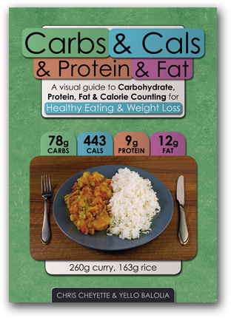
Aisling Snedker RD Clinicaldietitian.ie
1/14/2023

Slide 16
Post training or post event
50gCHO +10g protein
Power bar +200ml isotonic drink
200g yoghurt + cereal bar
Home made protein shake -see recipe
300ml flavored milk + 2 apples or 1 large banana
Breakfast cereal + cup of milk or fruit yoghurt
Cheese or meat sandwich + fruit
Aisling Snedker RD Clinicaldietitian.ie
1/14/2023

Slide 17
Finally – competition behaviour
Sleep properly in a good cycle
Between events – wrap up stay warmed up
Drink and eat
Relax – do not run around
Carbohydrate load - 10g /kg for 36hrs pre aevent
Hand hygiene
Aisling Snedker RD Clinicaldietitian.ie
1/14/2023

