Slide 1


Thame Swimming Club
Annual General Meeting
5 July 2023

Slide 2
Agenda
Welcome
Chair’s Report
Treasurer’s Report
Head Coach’s Report
Appointment of 2023/24 Captains & Vice Captains
Election of Committee
Questions and Feedback

Slide 3
Chair’s Report

Slide 4
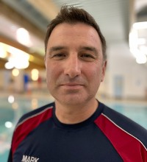
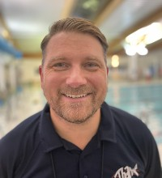
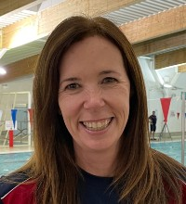
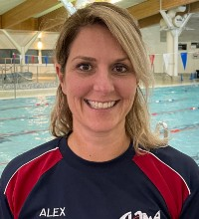
Thank you to all our Coaches, Committee & Volunteers
Mark
Head Coach
Damian
Asst Head Coach
Louise
Club Chair
Alex
Asst Club Chair

Slide 5
Our Vision
To inspire each and every swimmer to reach their full potential within a supportive, fun and collaborative environment

Slide 6
Club Development
Growing number of swimmers (highest for 5 years!)
Successful recruitment of new coaches and volunteers
Succession planning for coaches when their swimmers move up
Swimmers attendance levels are improving at all sessions
Land training has been successfully reintroduced
Swim camp to prepare for Counties
Swimmers invited on local talent program and county development programs
Successfully migrated the club on to SportEngine
Strong financial position

Slide 7
Club Objectives
To increase the number of swimmers who represent Thame at Counties and Regionals
Successfully retain and recruit coaches and committee to ensure stability
Improve the communication between the Club, its members, other swimming clubs and the local community
Ensure a robust parent volunteer program is in place to sustain the long-term viability of the club
Ensure the long term financial viability of the Club

Slide 8

SwimMark
Swim England’s quality accreditation for clubs
It recognises high standards of governance and offers resources to help clubs create the best possible swimming experiences for all, raising the quality of provision of swim clubs
TSC first became accredited in 2017 and has just passed its 2-yearly re-accreditation in June of this year
There are 16 elements that must be satisfied, requiring us to provide evidence of such things as:
  Club constitution, club development plan, budgets and annual accounts, codes of conduct, emergency procedures, safeguarding procedures, DBS checks, coaches’ qualifications and training needs, succession planning, risk assessments, membership processes, and more
Provides a great framework for managing the club on an ongoing basis

Slide 9
Key Dates
9 July: Mini Triathlon
9 - 10 Sept: Club Championships
21 - 25 Oct: Swim Camp
11 Nov: Awards Evening
25 - 26 Nov: BBATT

Slide 10
Welfare of swimmers
Helen Burton will now be the Welfare Officer with Alex Dodd supporting
First point of contact for children, parents and adults within the club who have a child safeguarding or welfare concern.
Welfare concerns can include bullying, anxiety, physical health issues.
To ensure that all relevant club members, volunteers and staff have an up to date DBS and appropriate child safeguarding training.
To ensure confidentiality is maintained and information is only shared on a ‘need to know’ basis
Youth Sports Nutrition
A series of online workshops to be arranged looking at training nutrition, competition nutrition etc
.

Slide 11
Parent engagement and support for the club
Thank you to those who kindly stepped up for committee roles and officials.
Without parent volunteers, we would not be able to offer our children the competing opportunities that we currently do.
Swim England ( Wavepower) specifies the ratios that are needed for adult to child supervision ratios for galas.
We need more Team Managers and Officials to be able to continue to take swimmers to galas and continue being a competitive club

Slide 12
Treasurer’s Report

Slide 13
Finance Update: YE 03/23
 | 2023 | 2022
 | £ | £
Income | 108,504 | 97,174
Expenditure | (83,811) | (98,569)
Profit/(Loss) for year | 24,639 | (1,395)
Club Reserves | 42,678 | 17,539

Slide 14
Finance Update
Large profit this year
Original costings before restructure included a Head Coach costs as previous years – Head Coach currently does not get paid.
Continued to build up strong reserves of £42K
Going Forward:
Increasing pool fees
Possible requirement to pay for Head Coach/ support Coaches
Build up reserves to ensure continuity of the club longer term
Continue to invest in club equipment

Slide 15
Head Coach’s Report

Slide 16
Appointment of Captains

Slide 17
Captains & Vice Captains 2023/24
 | Girls | Boys
Captains | Louise Birmingham | Jack Norman
Vice Captains | Freya Dodd | James Rampley

Slide 18
Election of Committee

Slide 19
Election of Committee 23/24
Role | Proposed
Chair | Louise Croft Baker
Vice Chair | Alex Dodd
Club Secretary | Lee King
Treasurer | Kate Rampley
Membership Secretary | Charlotte Clark
Head Coach | Mark Simms
Officials & Volunteers Secretary | Jo Sackett
Galas Secretary | Anna Galloway
Communications | Sarah Bradford
Health & Safety Officer | Will Hook
Welfare Officer | Helen Burton
Policies & SwimMark | Ruth Reed
Fundraising & Sponsorship | Jo Norman

Slide 20
Questions & Feedback

